Slide 1
Enterprise IT Transformation Advisor Training IBM Services Platform With Watson Approach With Clients
Enterprise IT Transformation Advisor Community
IBM Global Technology Services

Slide 2

Agenda – IBM Services Platform with Watson – Client Approach
Why would you choose IBM ahead of our competitors?
Value Proposition
It comes with it approach
Journey map approach
Strategic Differentiation
Competitive Analysis

Slide 3
Bank Customer – IT Reference Architecture
Digital
Transformation
Cloud
Analytics
Mobility
Social
Reshaping Customer Value Proposition
Transforming Operating Models
ITaaS Foundation
IT Services
and Applications
Service Catalog
Brokerage
Patterns & Orchestration
Infrastructure Services
IT Services
Application Services
Midrange
Network
Resiliency
Client Services
Client App
Storage
EUS
Backup
3rd Party Services
3rd Party App
Mainframe
Other Services
Fulfillment &
Management
Analytics
Cognitive
Automation
Governance
Metering
Service Management
Tools
Security & Compliance
Hybrid
Infrastructures
Traditional IT
Private Cloud (On-premise)
Private Cloud (Off-premise)
Public Cloud

Slide 4
Bank Customer – Current State
Reporting
Caribbean
Customer Satisfaction Survey Robot
OneView
Monitoring
Reporting
IBM ISM
Customer ServiceNow
Endpoint Management
Incident
Problem
Service
Requests
Asset
Feed
Service
Request
Incident Problem
Asset
Sysinfo
Reporting
Mexico
CMDB
Service
Catalogue
Change
CMDB
Asset
Monitoring
IBM uses Scotiabank Service Now for Change
Endpoint Management
Global Notification Manager
Dynamic Automation
TPC
Storage
Server Resource Manager
Servers Perf/Cap
ITM
OS/MW/DB
NetCool Omnibus
Event Correlation, De-duplication, Suppression
TAD4D / BigFix Inventory
Asset Scanning
ITNM
Network
BigFix
Endpoint Management
GSSD
IBM Hardware
TADDM
Discovery
Omegamon
MF
SCCM
Workstations
Traditional MF, Server, Network, Storage, DB and Middleware

Slide 5
Bank Customer – Future State
ITaaS Foundations
Orchestration – (vRealize, vRO, vRA)
Customer Satisfaction Survey Robot
OneView
IBM Services Platform with Watson
IBM ServiceNow (global)
Incident problem
Customer ServiceNow
Watson
Natural Language Interface
Data Lake
Cognitive Delivery
Insights
(CDI)
Watson Analytics
Incident
Problem
Service
Requests
Service
Request Catalogue
Asset
Feed
Service request
Service
Request
Incident Problem
Asset
CMDB
CMDB
Service
Catalogue
Change
CMDB
IBM uses Customer Service Now for Change
Global Notification Manager
Dynamic Automation
TPC
Storage
Asset (AMDB, Blazent, Chargeback, ATP/Bravo)
ITM
OS/MW/DB
NetCool Omnibus
Event Correlation, De-duplication, Suppression
CIRBA
Servers Perf/Cap
ITNM
Network
BigFix Inventory
Asset Scanning
GSSD
IBM Hardware
BigFix
Endpoint Management
Omegamon
MF
Traditional MF, Server, Network, Storage, DB and Middleware

Slide 6

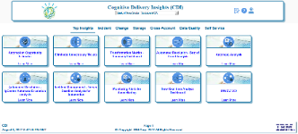

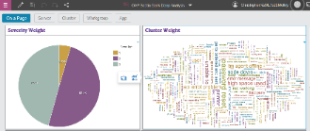

Bank Customer – Cognitive Service Management
4
Service Now
Service Now CMDB
3
Perl Scripts
“Simple”
Dynamic
Automation
Complex Open Ticket Info
1
Platforms
Pre Processing
IBM Services Platform with Watson
2
7
Traditional Monitoring
Anomaly Detection
General
Knowledge
Watson
Cognitive Tool
Product Documentation
Correlation Analysis
6
Mainframe
Omegamon
SMF Records
z/OS Syslog
DB2 logs
CICS logs
zAware
IOA/z
Netview
Multi-Account Data
IBM/GTS Knowledge
Cognitive Delivery Insights (CDI)
A
Interactive
Q&A
Operator Processes
5
Specific Data & Processes
Customer Knowledge
Midrange
“Complex”
A
ITM
SRM
CIRBA
Big Fix Inventory
Dynatrace
Netcool
Predictive Insights
TPC
Level 2/3 Sys Admins
Data Lake
Watson Analytics
Application Performance Management

Slide 7

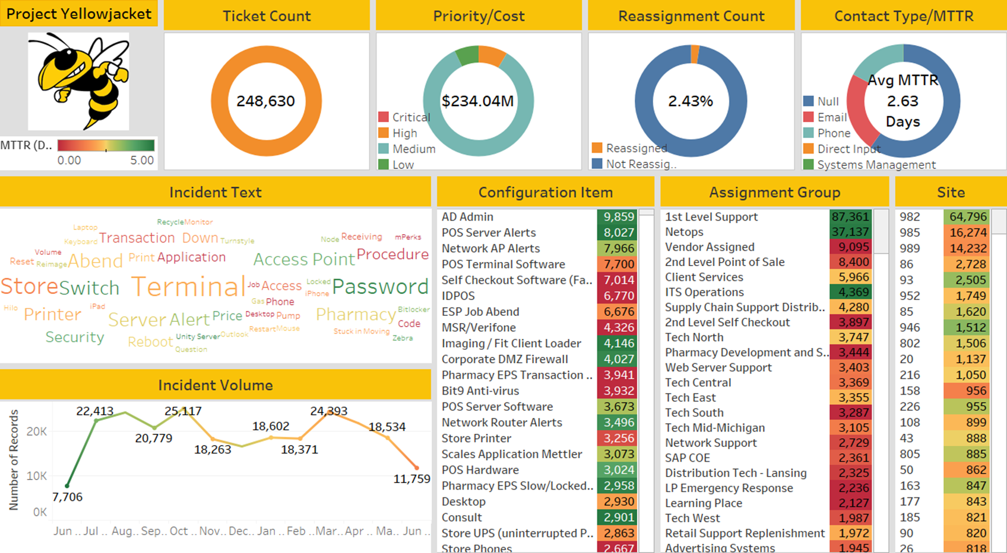

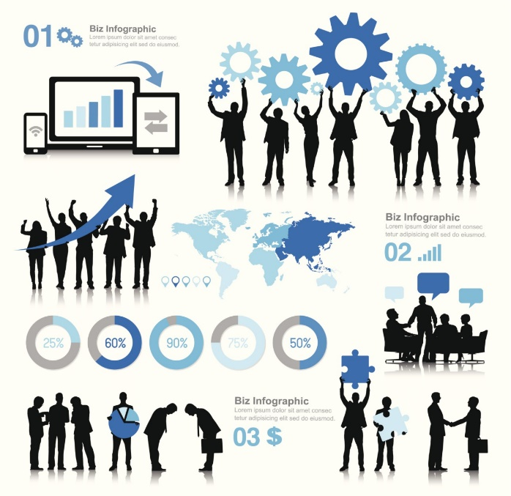



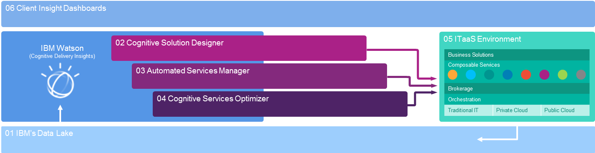
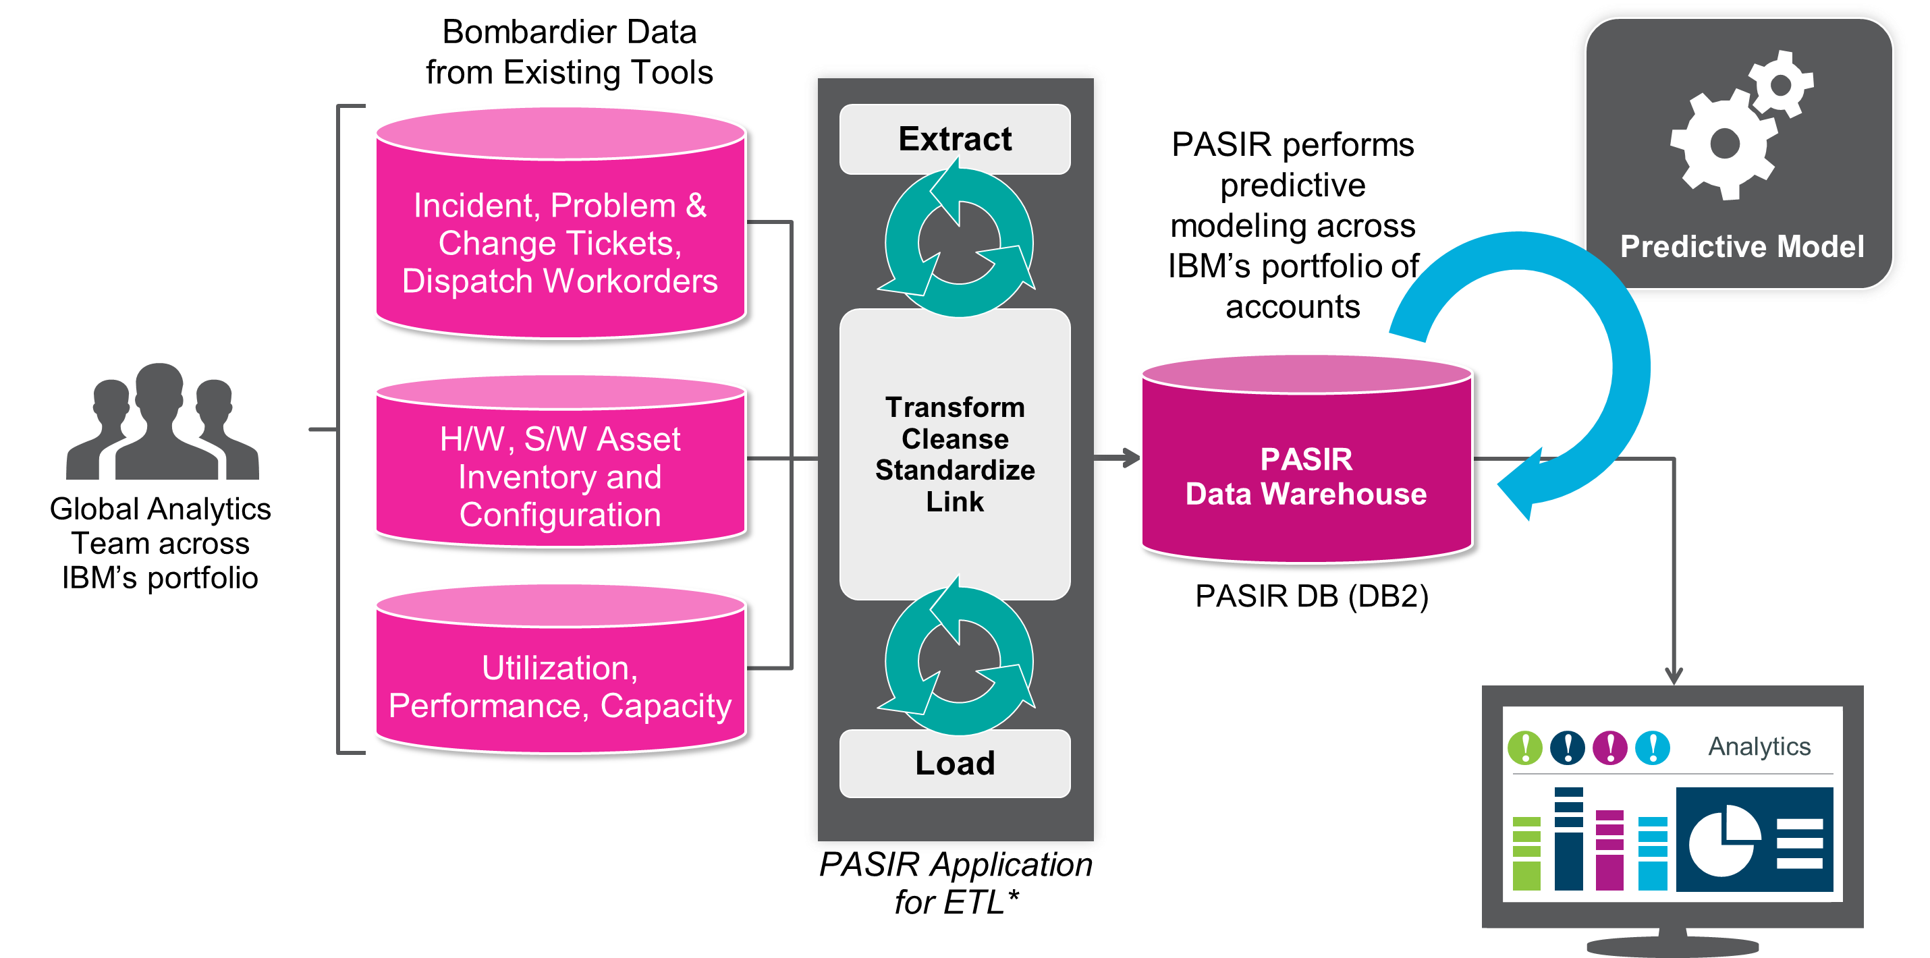

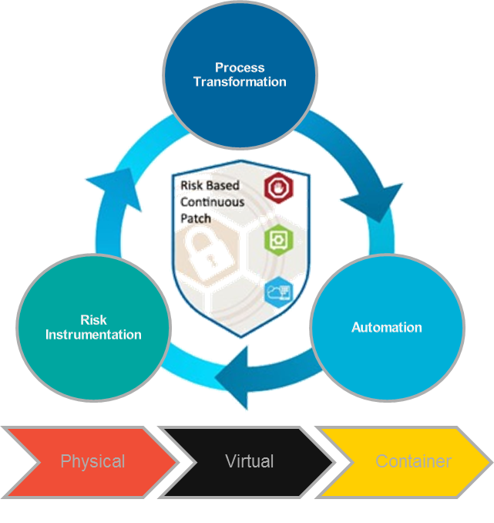
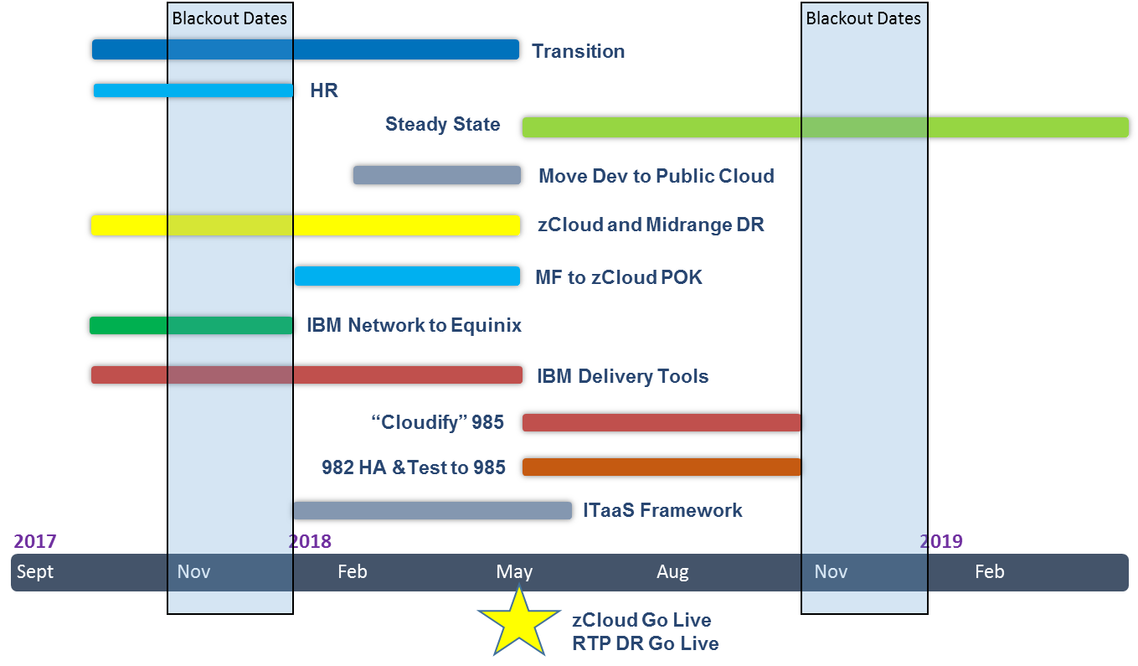


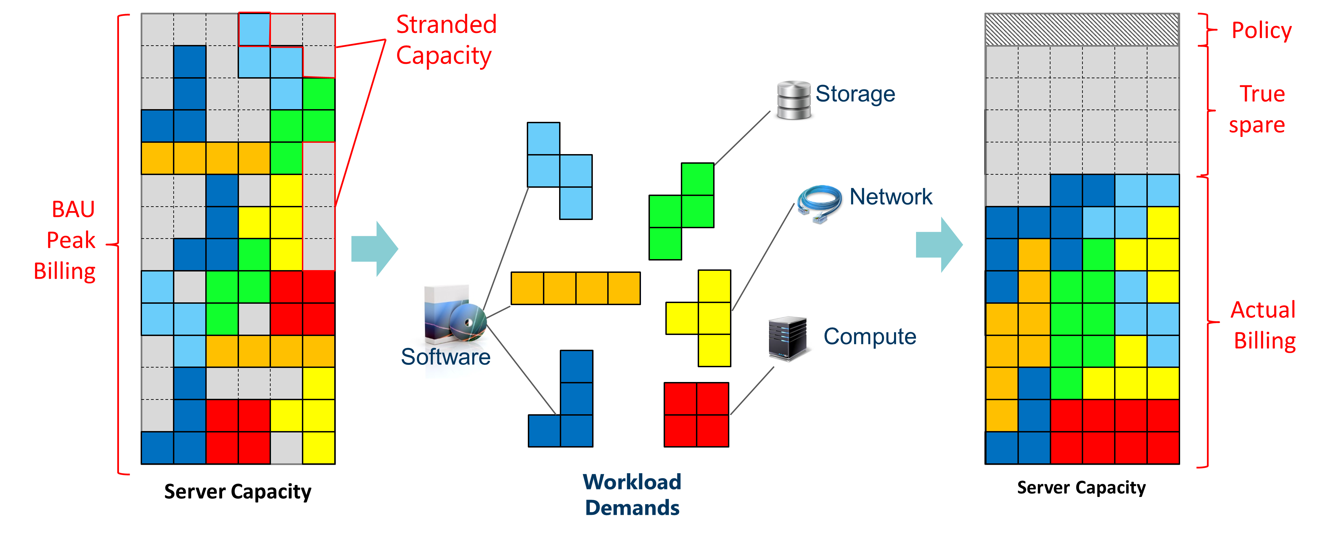
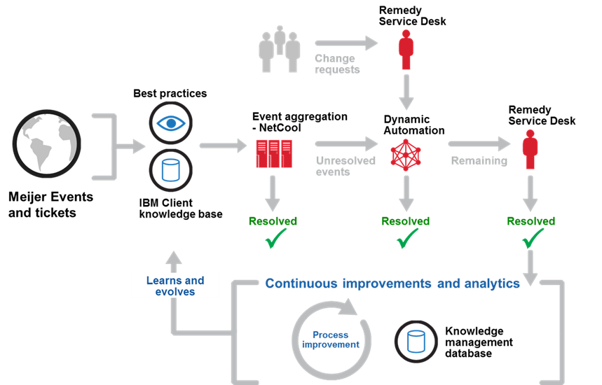
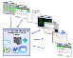



Journey Map Approach
Today
Transform to Future Operating Model
Continue Transformation
Future
Execute a “Cloud-First” Strategy to effectively position the new IT environment to take full advantage of current and future technology and services, driving favorable business outcomes.
Meijer 982
Meijer 985
Leverage customer investment in 985 for production and test midrange workloads while introducing an IBM out-of-region Disaster Recovery capability
Move assets from 982 to 985 and cluster by tier
Migrate Mainframe to IBM zCloud
Create out-of-region DR in IBM Raleigh, NC for workloads
Complement Meijer tooling with IBM
Application Rationalization Execution
As applications are rationalized, move them to the appropriate cloud platform using ITaaS framework
Align business service levels to application and infrastructure tiers
Apply transformation and “CloudFirst” strategy migrating appropriate production workloads to cloud
Support Scaled Agile Framework (SAFe) through Dev/Ops enabled infrastructure
High average MTTR (2.6 days) for incidents – limited automation
Customer
Production
Infrastructure features a Private Cloud for Meijer environment orchestrated with VMware VRealize orchestration and Densify capacity planning, enabling dynamic capacity adjustments through automated monitoring and provisioning of resources. This will enable a consumption-based model and positions for effective management of hybrid cloud environments as customer considers future cloud technologies.
Customer IT environment is positioned to take advantage of current and future Cloud technology to drive favorable business outcomes well into the future.
IBM Poughkeepsie (zCloud)
Asynchronous Replication
IBM
Raleigh (DR)
Speed of IT and Scalability: ITaaS is the future operating model that will improve the speed, flexibility, and capability of IT to address the digital needs of Meijer customers.
ITaaS Hybrid Cloud Optimized with…
Disaster Recovery
Out-of-region solution addressing the needed RTO and RPOs dictated by Meijer tiering strategy
IBM Cloud Broker
IBM Services
3rd Party Services
Security
Integrated security framework across IT legacy and cloud managed environments
IBM Services Platform with Watson
Resiliency: Complement customer security team, improving the security posture, while mitigating risk via an out-of-region DR solution.
Limited use of cloud with integrated legacy environment
Orchestration & Automation
Traditional IT
Private Cloud
Public Cloud
Infrastructure environment architected to 100% HA vs tiered to business priority
… IBM Services Platform with Watson
Transformation Initiatives
Implementation of IBMs Cloud Brokerage solution for the distribution of workloads based on cloud provider profiles and cost provided via a service catalog
Leverage both hybrid cloud and advanced cognitive automation for delivery model to drive efficiencies and added business value
Generate Savings by lowering cost of ownership through introduction of cognitive analytics and advanced automation into IT operations through IBM Services Platform for Watson (ISPW).
PASIR
Risk-based Patching
Cognitive
Delivery Insights
Business risk mitigated in the event of a disaster by implementation of tiered Resilient Disaster Recovery design
Densify
Dynamic Automation
Robotic Process Automation
No out-of-region Disaster Recovery infrastructure that contributes to higher business risk
Pattern Enablement: IBM to provide execution of patterns and blueprints for agile and dev/ops to support SAFe Framework
Lower Total Cost of Ownership offering new investment opportunities to further Meijer’s digital strategy
Bluemix and IBM zCloud
IBM Cloud for public cloud Dev environment
IBM zCloud for existing mainframe
Storage as a Service
Storage as a Service – consumption base, with IBM technology
© 2017 IBM Corporation

Slide 8
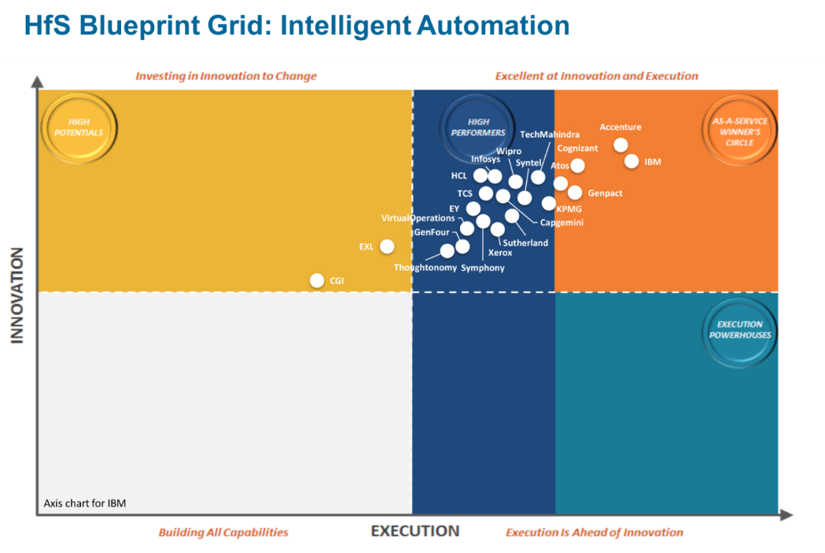
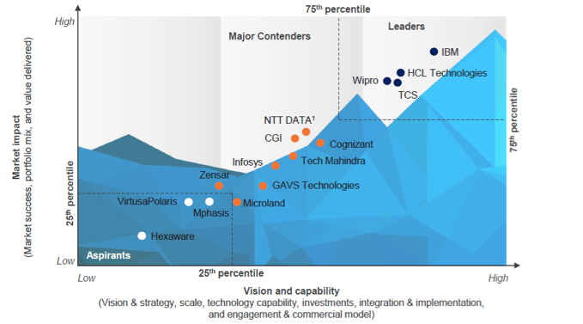
Competitive Positioning
IBM is positioned as a Leader in the 2017 Everest Group PEAK Matrix for solutions – IT Infrastructure Automation
IBM is in the Winner’s Circle in the 2016 HfS Blueprint for Intelligent Automation
Everest Group Performance | Experience | Ability | Knowledge (PEAK) Matrix™ for solutions – IT infrastructure automation

Slide 9





Competition – Service Providers
Cognitive automation platform that leverages machine learning, natural language processing, deep learning, semantic ontologies, pattern recognition, etc.
Claims to offer:
Digital virtual agents
Predictive systems
Cognitive process automation
Visual computing applications
Knowledge virtualisation
Robotics and drones
Works alongside other platforms like FixOmatic, ServiceNxt and SmartView
Cuts across applications, business process, and service desk – used as part of their infra / apps / business process managed services
Wipro is involved in joint use case development with clients with revenue sharing from future proceeds
TCS ignio – new Digitate subsidiary
Mostly focused on IT infrastructure mgmt use cases (plans to extend to apps, back-office and front-office)
ignio for IT Operations
ignio for Batch
ignio for SAP
Connects with IT management / monitoring tools to collect, analyze, and act on systems / operations data
Sold as a licensed platform and delivered as an on-premise dedicated deployment … “services as software”
Bundled with TCS infra managed services to deliver committed operational efficiencies without sacrificing margins
Not the most sophisticated, or complete automation solution in the market, but perceived as “simple to understand / implement / operate”
Not a “true platform” but a tool (SDK APIs are not exposed)
Cuts across data center services, service desk, application services, DevOps, business process automation
Made up of 40+ modular components – monitoring layer (MTaaS), machine learning components, various automation modules, orchestration components, knowledge management, analytics and reporting layer - all tied together with their ITSM base platform called HCL Gold Blueprint
Bundled with HCL’s infra / apps / business process managed services, but open to selling as a licensed platform
IT operations automation currently offered by HCL has limited self-learning and self-healing features
Targets L1, L2, and L3 activities within both infrastructure and application management
Claims to offer:
Advanced data analytics and machine learning platform
Knowledge platform
Robotic Process Automation, Predictive Automation and Cognitive Automation
Strong messaging around FTE reduction within existing managed services engagements
Being taken by Infosys to all its existing clients aggressively
Infosys’ value proposition is primarily around FTE reduction
Self-learning capabilities to drive/manage complex IT processes is not a strong message
http://www.wipro.com/holmes/
http://www.digitate.com/
https://www.hcltech.com/autonomics-and-orchestration#
https://www.infosys.com/nia/

Slide 10
Case Study: The BBVA Omega Project

Slide 11
The BBVA Project
Client, Challenge and Solution
Impact and Lessons Learned
Client Background and Challenge
BBVA is a customer-centric global retail financial group, full range catalogue of financial and non-financial products and services. Solid leadership position in the Spanish market; largest financial institution in Mexico.
Digital transformation is a strategic priority, moving quickly off traditional MF towards a more optimized, reliable, flexible and scalable infrastructure.
Challenge:
BBVA needs a dynamically scalable infrastructure, aligned with the new technological trends to further enhance its competitive profile.
Client Value and Business Impact
Predictable cost of legacy environment and variable charging model to reduce cost along with cloud migration programme.
Stable legacy operations and shift resource focus and skills to cloud.
Technology infusion and service stability.
Establish a global IT operating model.
Enterprise Transformation Solution
Full 10-yr SO solution:
Sites in Spain and Mexico.
Technical towers covering “Legacy” stack: Mainframe, Distributed Systems and Storage, Networking and Security.
155 Customer HC being transferred to IBM
Strong focus on tooling and automation.
“NextGen” stack scope:
Hardware provisioning and maintenance.
Monitoring services.
IBM Value and Business Impact
~1.5B combined Spain and Mexico TCV
Spain signature (920M) achieved Sep 2017. Mexico signing expected 1Q 2018.
Additional business expected in the NextGen area, subject to superb delivery and demonstration of IBM capabilities in the Legacy stack.
What makes this project special
One of the largest deals in which a significant portion of the ISPW toolset has been solutioned.
The Business Case has a significant dependency on the toolset being able to demonstrate its capabilities as to achieve it.
A major business opportunity to extend our services into the NextGen scope via our EITaaS model and after having demonstrated a superb delivery.
Reused Offerings and Assets
ISPW marketing materials. ITaaS marketing materials and experiences.
Standard GTS Offerings in Security, Network, Resiliency and Systems.

Slide 12



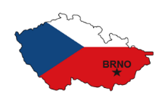


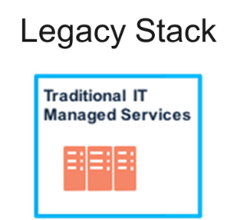

Delivery locations and principles
Services are highly dependent on Spanish language skills.
Incremental transfer to India GDC expected as service matures and language skills are available.
Network services for Spain to be provided from Brno.
Tres Cantos 1&2
Lago Esmeralda
Vaguada (DR)
Mainframes, Distributed Systems, Network.
IBM to optimize via:
Process review and optimization.
Automation initiatives.
Server and LPAR consolidation.
Storage optimization.
Contract and vendor management.
Keep the toolset that works, and enhance it if required for the purpose of IBM scope.
Monterrey (DR)
La Vela (CIB)
BBVA HR
Transfer
+
3rd party subcos
ATA SA de CV
acquisition

Slide 13
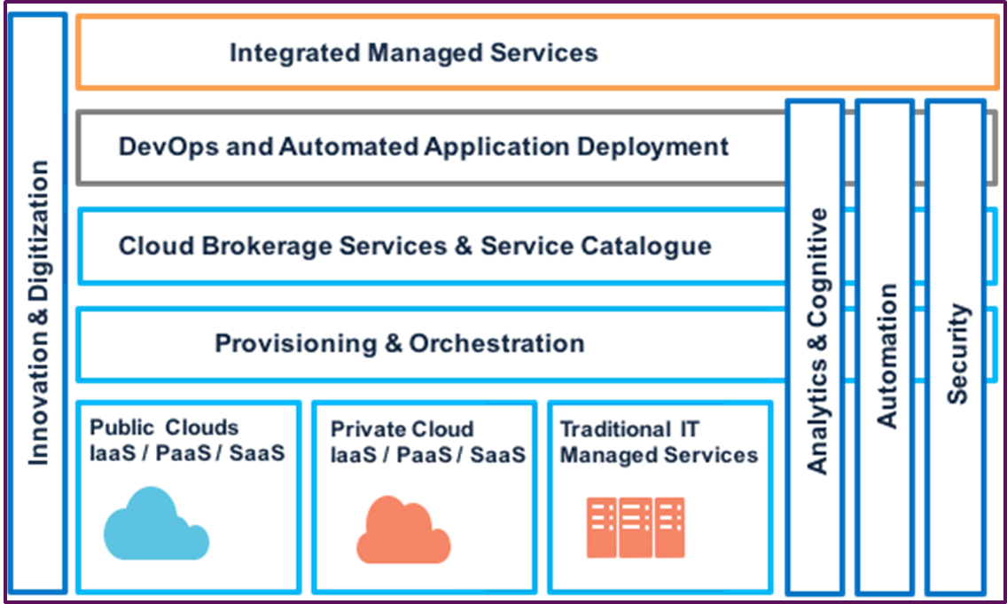
Understanding the scope (1/3)
Legacy Stack
NextGen Stack
Mainframes, Distributed Systems, Network.
IBM to optimize via:
Process review and optimization.
Automation initiatives.
Server and LPAR consolidation.
Storage optimization.
Contract and vendor management.
Major initiatives to be validated with BBVA.
Keep the toolset that works, and enhance it if required for the purpose of IBM scope.
IaaS / PaaS based on RedHat OpenStack.
BBVA to own:
Define and design the strategy and architecture.
Define migration and extensions into public cloud.
Deploy DevOps methodologies across all stacks.
IBM to provide:
Hardware and maintenance
Basic up/down monitoring

Slide 14
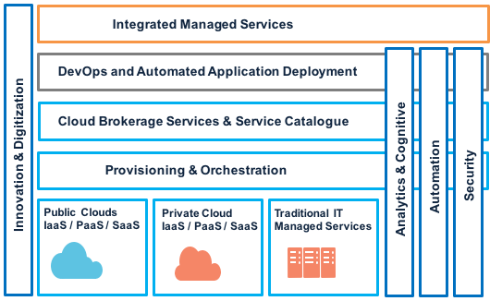
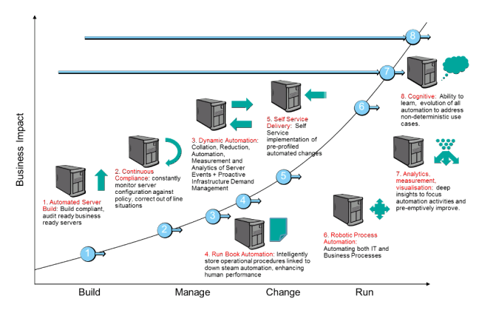
Understanding the scope (2/3)
ISPW Content
Automated Server Build
Continuous Compliance
Self Service Delivery
Dynamic Automation
Robotic Process Automation
Run Book Automation
CDI / SDI
PASIR
IBM scope

Slide 15
Understanding the scope (3/3)
Evolution of Automation initiatives and ITaaS to a next generation platform which continuously preempts problems and optimizes every aspect of the client’s environment
01 IBM’s Data Lake
02 Cognitive Delivery Insights
+ Cognitive Micro Services
+ Knowledge Modules
06 Client-Centric Dashboards
Operations Data from all Client Environments
ITaaS Environment
05 Cognitive Solution Designer
Workloads
Tech Leaders
Services Capabilities from IBM and Other Providers
IBM Services
Brokerage
3rd Party Services
04 Cognitive Services Optimizer
Orchestration
Data Sharing Partnerships
Operations
Architects
Software-Defined Hybrid Cloud Infrastructure
Client Environment’s Data
03 Cognitive Services Manager
Traditional IT
Private Cloud
Public Cloud
Administrators
Omega Scope
Automated Server Build
Continuous Compliance
Self Service Delivery
Run Book Automation
Cognitive Dynamic Automation
Robotic Process Automation
Aspirational Scope (uncommitted)

Slide 16
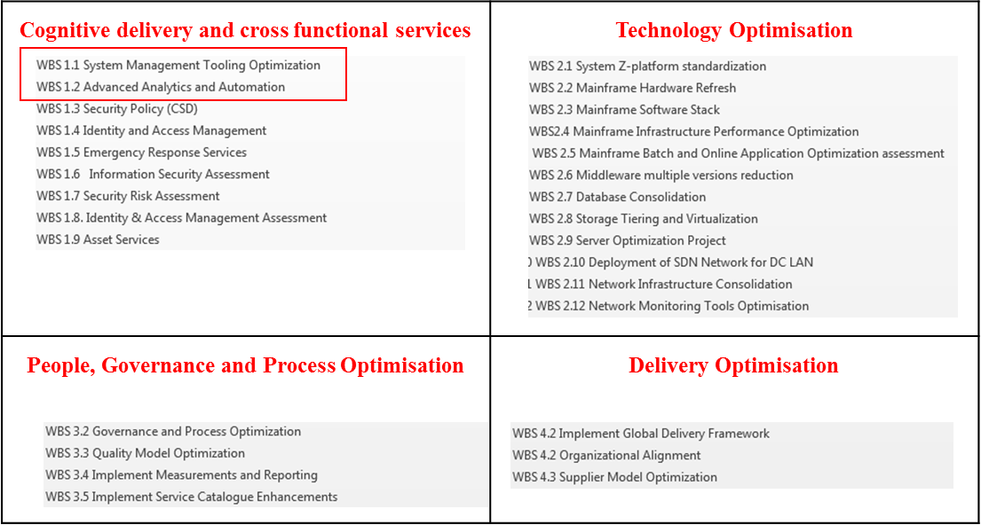
Optimisation (Transformation) workstreams

Slide 17


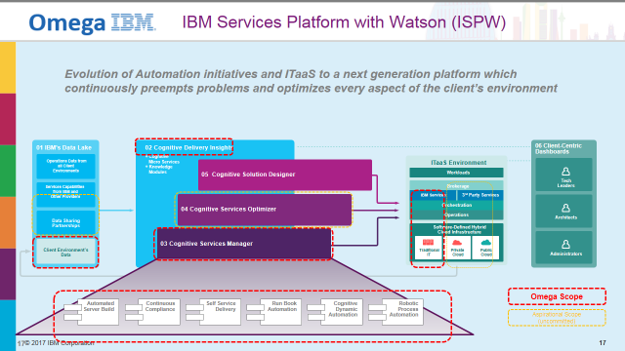
Project Timeline – ISPW Content during Optimization (Transformation)
2017
2018
2019
2020
Q4
Q1
Q2
Q3
Q4
Q1
Q2
Q3
Q4
Q1
Q2
Q3
Q4
SPA Transition
SPA Transformation
MEX Transition
MEX Transformation
Oct 1st 2017 SPA Transition starts
Nov 22nd 2017 Project Tools Workshop
March 1st 2018 SPA: SCD & Transform. starts
Q1 2018 MEX: Transition starts
Oct 1st 2020 SPA Transform. ends
Optimization Scope (28 workstreams)
WBS 1.1 System Management Tooling Optimization (12 mo)
WBS 1.2 Advanced Analytics and Automation (19 mo)
Cognitive Delivery & cross functional services
Technology Optimization
People, Governance & Process Optimiz.
Delivery Optimization

Slide 18
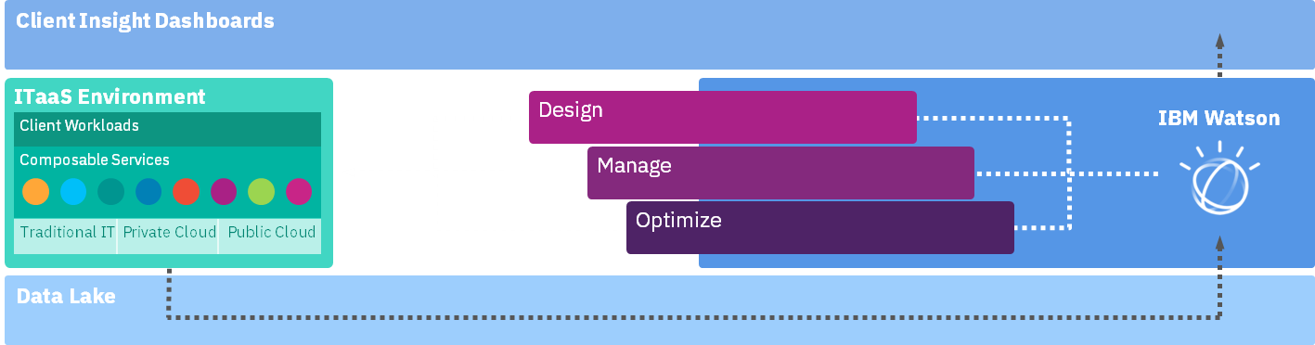
Automation tools in scope
Client Insight Dasboards
CDI
CDI – Cognitive Delivery Insights
PASIR – Predictive Analytics for Server Incident Reduction
SLA – Server Lifecycle Automation
ASB – Automated Server Build
CC – Continuous Compliance
SSD – Self-Service Delivery
RBA – Run Book Automation
RPA – Robotic Process Automation
DA – Dynamic Automation
Design
Optimization
PASIR
Management
SLA ASB
CC
SSD
RBA
RPA
DA

Slide 19
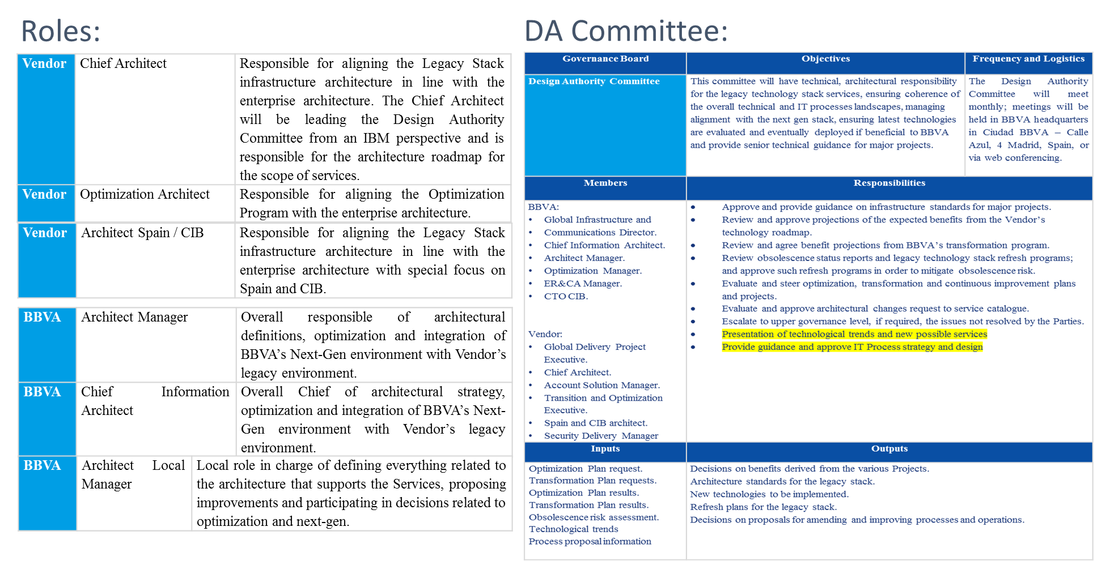
Technical Governance

